Slide 1
CL TNBC Reversion Figures for Grant
June 12, 2019

Slide 2
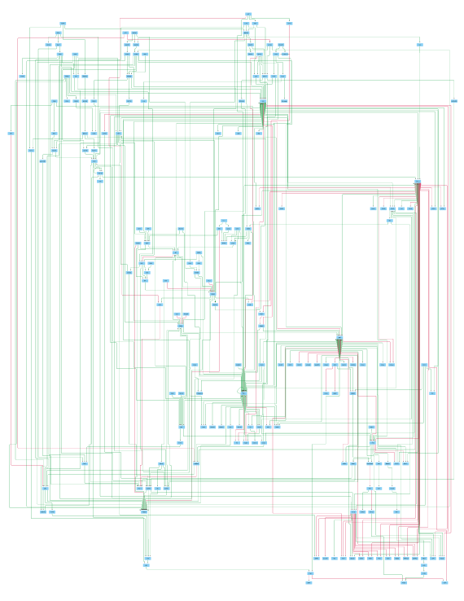
Fig 1: Preliminary Intracellular Signaling Network MDA-MB-231
198 Nodes, 387 edges. Red edges denote inhibition, green edges denote activation

Slide 3
Figure 2: Heatmap of Preliminary Network Genes on RNA-Seq average normalized expression values
Network genes are differentially expressed among MCF10A and MDA-MB231 cell lines

Slide 4
Figure 2: Heatmap of Preliminary Network Genes on RNA-Seq normalized expression values samples and replicates
Network genes are differentially expressed among MCF10A and MDA-MB231 cell lines

Slide 5
Figure ?: Heatmap of Preliminary Network Genes on attractor values
Network genes’ attractor values differ between MDA-MB231 and MCF10A
Note: scaling with node values

Slide 6
Figure ?: Heatmap of Preliminary Network Genes on attractor values
Network genes’ attractor values differ between MDA-MB231 and MCF10A
Note: no scaling

